Slide 1
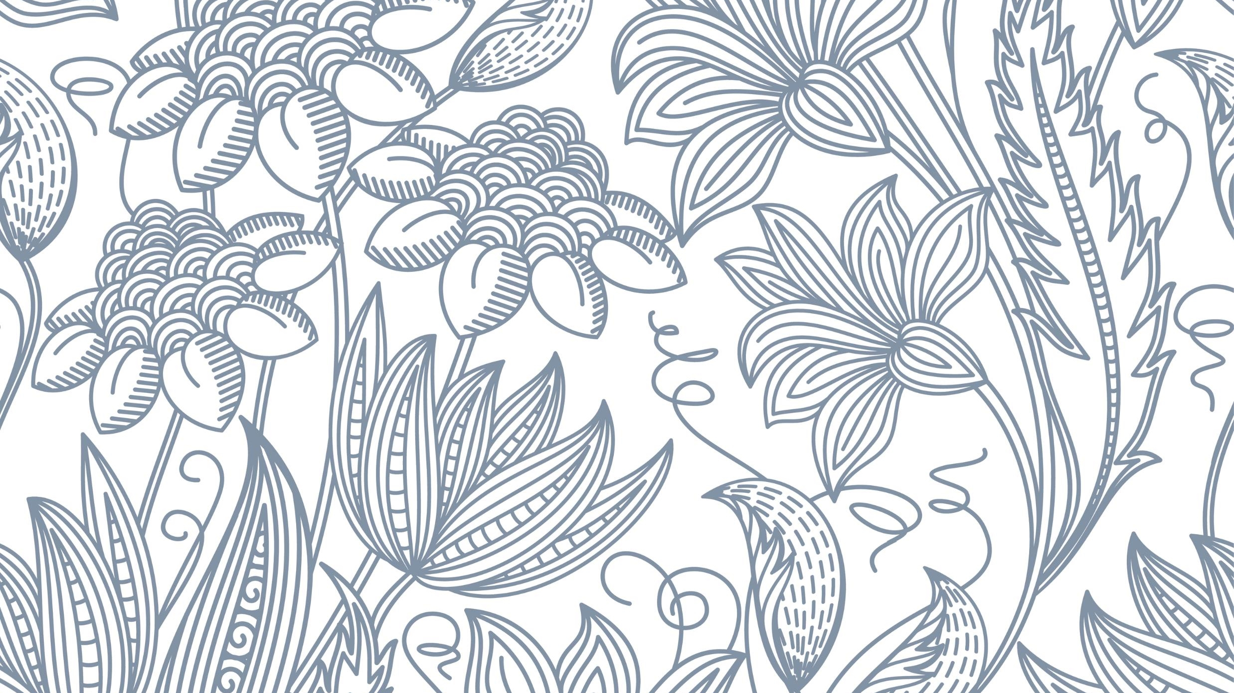
Python reinforcement
Mihala Nasrin P A

Slide 2
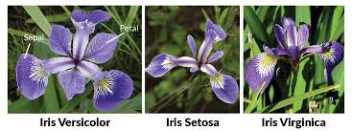
About Dataset
Dataset consists of 150 samples of iris flowers from three different species: Setosa, Versicolor, and Virginica.
Attributes: Sepal length, Sepal width, Petal length, Petal width

Slide 3
Data Cleaning
Introduced NAN values
Filled the missing values
Removed Duplicates

Slide 4
Numpy & Pandas
Numpy – Mean,Median and Variance
Pandas – Filtering rows, Grouping data and finding average

Slide 5
Exploratory Data Analysis
Histogram
Scatter Plot
Box Plot

Slide 6
Time Series

Slide 7
THANK YOU

